Slide 1

Year 11 Revision Evening
Thursday 21st October 2021
Support for revision – English and MAThs

Slide 2
Aims of this evening:
Welcome
To share support for your child
Guidance for English GCSE
Guidance for Maths GCSE
How to help at home.
Useful online resources.

Slide 3


Revision Strategies and English GCSE

Slide 4
GCSE English Literature and
GCSE English Language
GCSE English Literature
Two papers
Reduced content
GCSE English Language
Two papers
Dates to be confirmed
No "Sign of Four"

Slide 5
GCSE English Language and Literature
No tier of entry
Every student sits the same exam
Students prepare for two qualifications:
GCSE English Literature
GCSE English Language
Spoken Language endorsement- does not count towards ‘grade’, but is shown on certificate as Pass, Merit or Distinction

Slide 6
What do I need?
A copy of the set texts- TAHS online shop- Year Ten Lit Pack
  Romeo and Juliet
  An Inspector Calls
Lots of black pens
Absolute willingness!
English Snap Revision guides- Will be available on the TAHS online shop

Slide 7
How do we prepare students in English?
Read texts in class/ set for homework
Supported with activities
Build skills for Language and Literature
Assessed ‘like the GCSE’
SWaNS- focused feedback for improvement

Slide 8
How we ‘read’ and ‘analyse’ in English
What is a writer saying?
How is that shown to us?
Why did they make that choice? Why do they want us to feel?

Slide 9
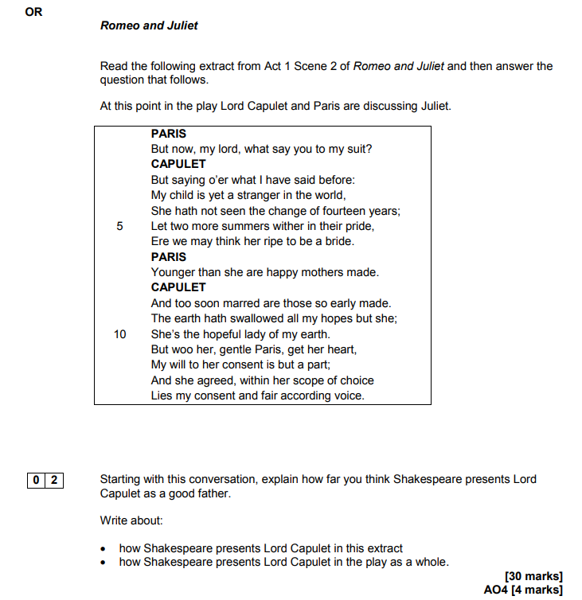
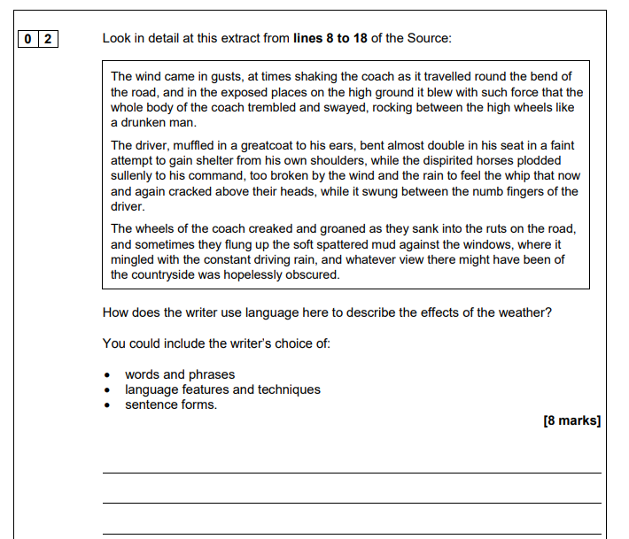
Shorter responses
Longer essay style responses

Slide 10
How can my child revise for English?
Students need to read regularly
  20 minutes three times a week
  Fiction or non-fiction
  Actively build vocabulary
How can you help?
  Help them choose their reading books
  Listen to them read
  Read to them
  Discuss what their reading and discuss newspaper articles with them
  Talk about and introduce them to new vocabulary

Slide 11
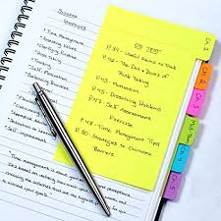

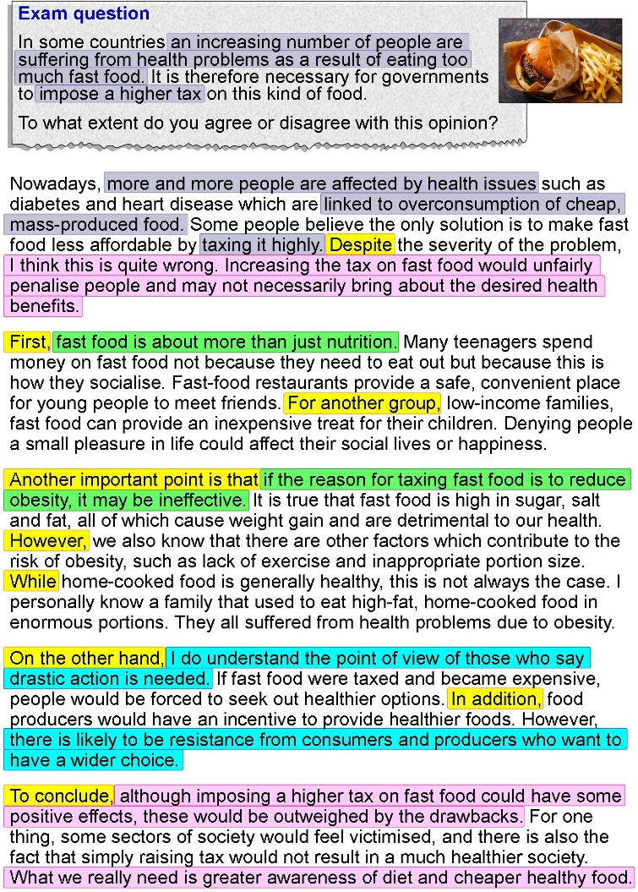
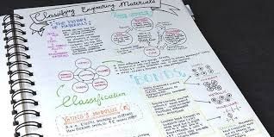
What can English revision look like?
Parents can ask students to:
List the key words on a topic
Explain the key words on the topic
Explain the full answer with you using the key words as bingo cards
Teach you about a topic
Just reading things does not work
You have to ‘fix’ the information by writing it down.
Take a longer piece of writing and highlight key points
Make short notes based on your key points
Then paraphrase trying to make it shorter
Until you get to key words
Tip 1: Make note on notes

Slide 12

Get them to write ‘notes without notes’
Time your child to complete an answer
Write and answer their own questions
Get them to ‘teach’ you, but have their notes and highlight everything they say
Complete test papers and parents read over them
Use the internet
to create notes
TIP 2: Self test on the set texts

Slide 13
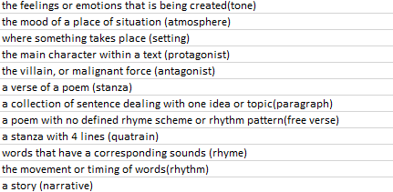
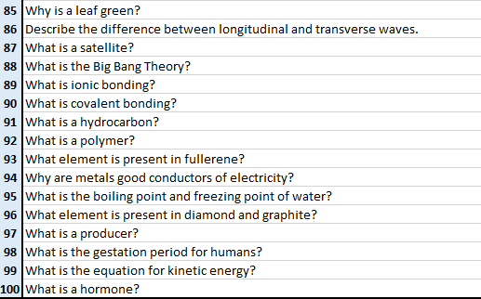

TIP 3: Do It Properly
Start with the hard stuff
Vary your method
Build up your stamina
A revision guide alone isn’t revising
They SHOULD have ‘something’ for us
Vary your texts
Take away distractions

Slide 14
Useful websites
Useful Websites
BBC Bitesize GCSE English Language
http://www.bbc.co.uk/education/subjects/zr9d7ty
BBC Bitesize GCSE English Literature
http://www.bbc.co.uk/schools/gcsebitesize/english_literature/
Youtube
Search for any “Mr Bruff” videos
GCSE POD

Slide 15
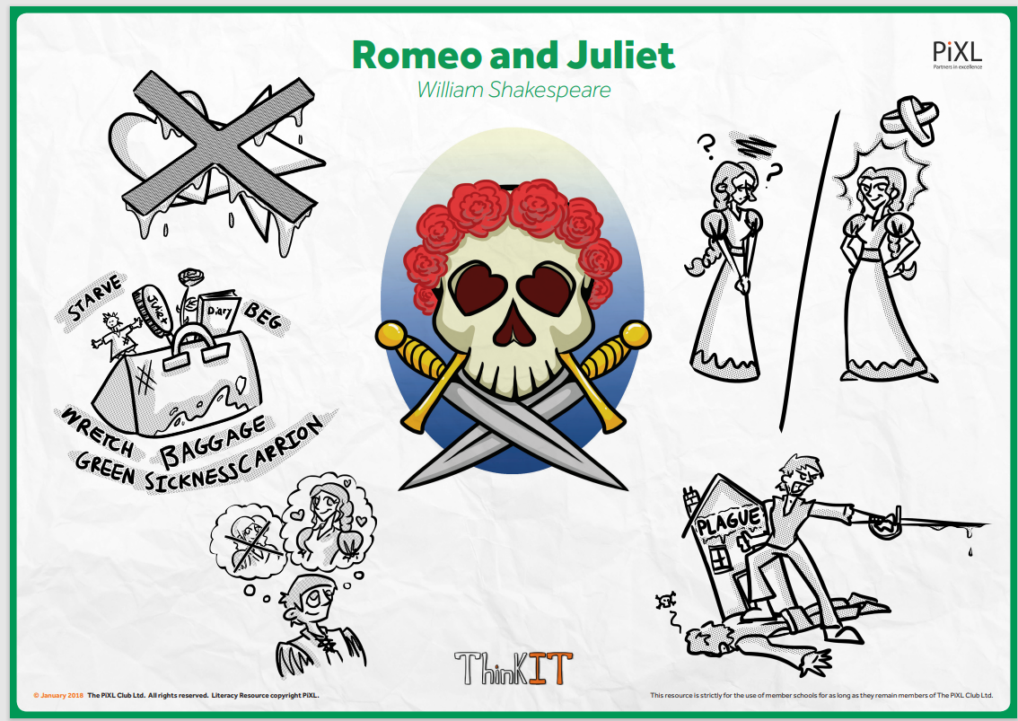
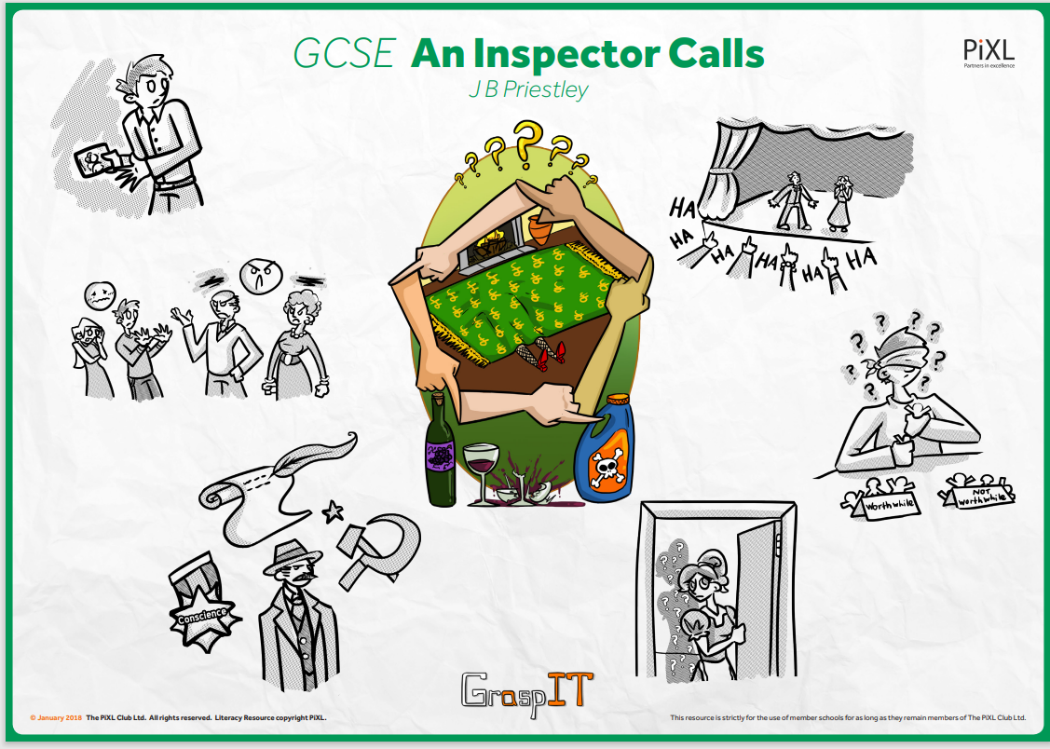

Slide 16
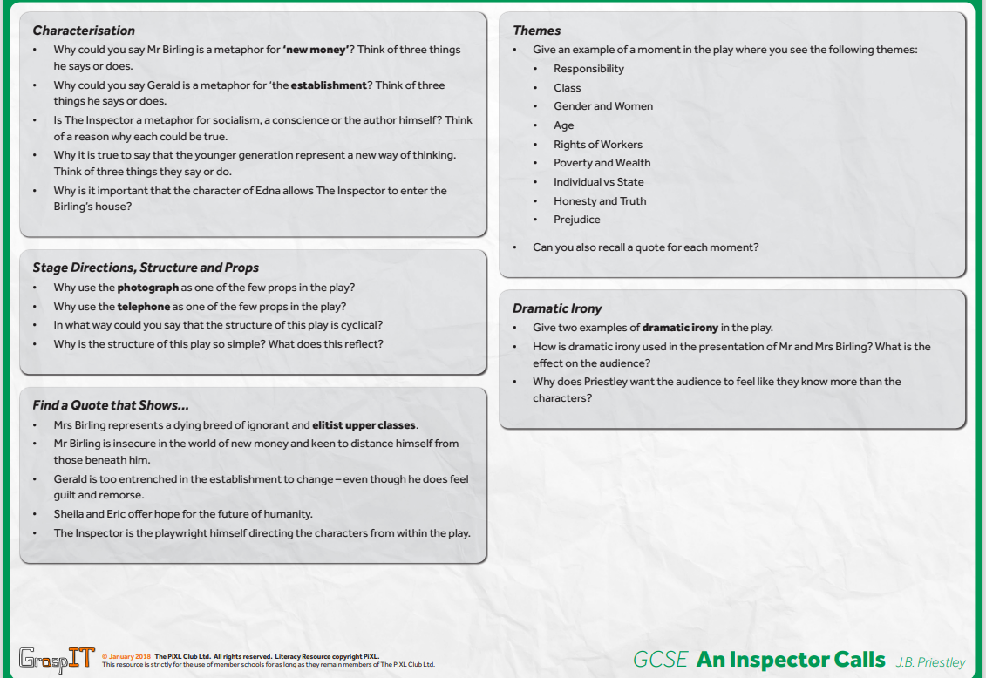
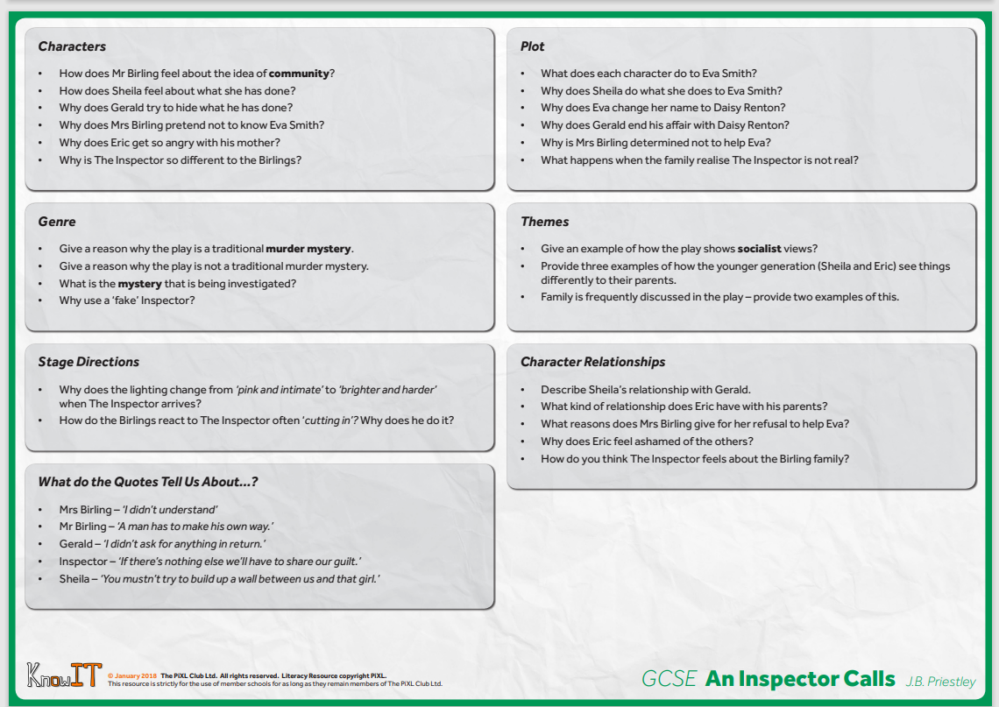
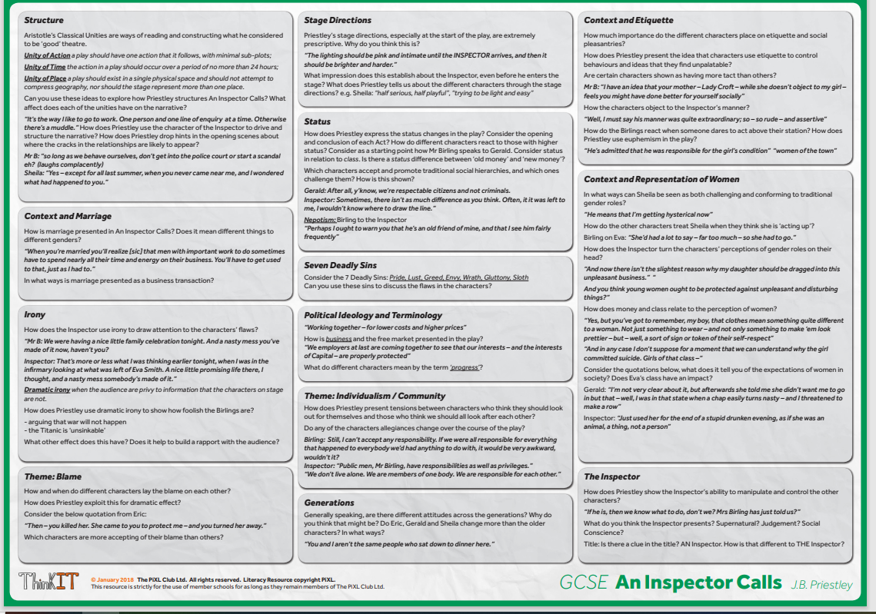

Slide 17

Revising Maths

Slide 18
AQA Mathematics 8300
Higher Tier – grades 9-4
Foundation Tier – grades 5-1
3 exams:
Paper 1 is a non-calculator paper
Paper 2 and 3 are both calculator papers

Slide 19
GCSE Mathematics
Any topic could come up on any paper
A mix of question styles including single mark questions, multi-step problems and multiple-choice questions
The questions get more difficult as you work through the papers
A formula sheet will be provided

Slide 20
What do I need?
Formula sheet – you need to be able to use these
Revision guide (given out during lockdown)
2 Black Pens
Pencil
Ruler
Compass
Protractor
Rubber
Scientific calculators £8.50 **
Maths sets £1.20 **
** available to buy from the TAHS Online Shop

Slide 21
How do we prepare students in maths?
Model answers in class
Regular recapping of previous work
Regular homework
Half termly assessments throughout the GCSE course - these are past or practice exam papers.
SWANS – focused feedback for improvement

Slide 22
Types of Questions
AO1 – Use and apply standard techniques (40%)
AO2 – Reason, interpret and communicate mathematically (30%)
AO3 – Solve problems within mathematics and in other contexts (30%)

Slide 23
Communicate mathematically
Show all workings (even if really easy)
01
Set out clearly
02
Write a final sentence for your answer
03
For geometry questions - all used rules must be stated in the correct mathematical language
04

Slide 24
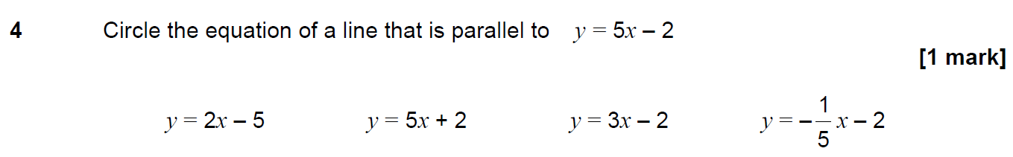
Foundation / Higher Question – AO1

Slide 25
Foundation Question – AO2

Slide 26
Higher Question – AO3

Slide 27
How to Revise Maths
Practice
Regular practice
Learn
Learn key facts and formulae
- make revision cards
- make posters
Learn
Learn meanings of key words
Use
Use a revision website and your revision guide
Complete
Complete lots of practice papers

Slide 28
Area
        = length x width
        = base x height ÷ 2
= length x height
= ½(a + b) h
= πr²

Slide 29
Key Facts
SOH CAH TOA
BIDMAS
a + a + a = 3a but a x a x a = a³
Calculator buttons
square x², cube x³
square root √, cube root ³√
powers x
Fractions

Slide 30
Key Words
integer – whole number
evaluate – work out – get a number answer
construct – use a compass and ruler
factorise – put brackets in
estimate – round each number to 1 significant figure before doing the
calculation

Slide 31
Useful Websites
www.vle.mathswatch.com
Username: schoollogin@tahs
Password: triangle
www.corbettmaths.com/5-a-day/gcse/
www.GCSEpod.com

Slide 32
Year 11 Revision Evening
Thursday 21st October 2021
Support for revision – English and MAThs

