Slide 1


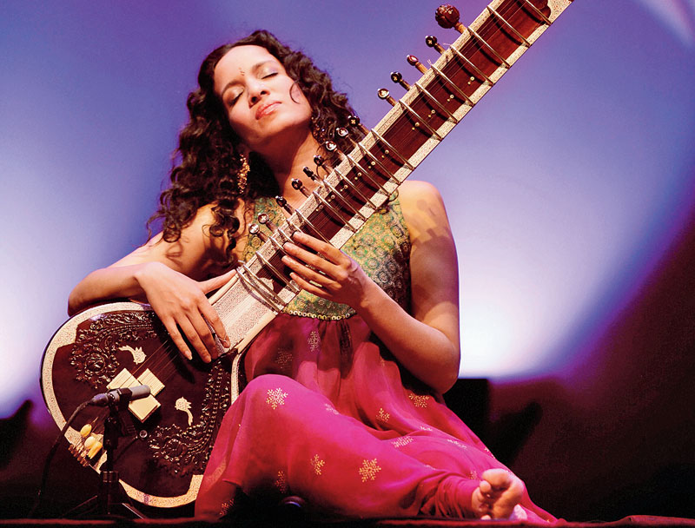
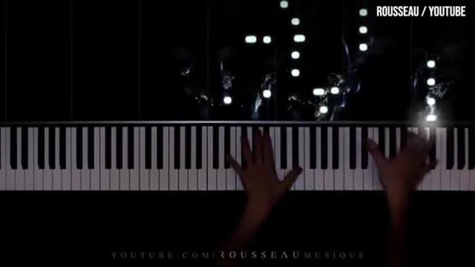
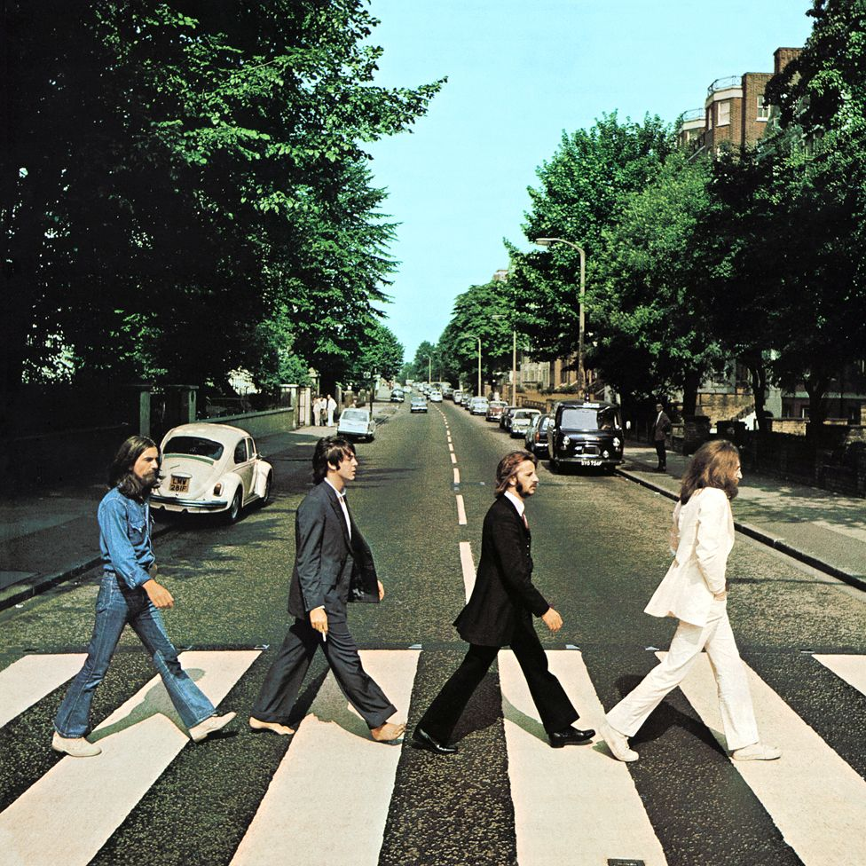
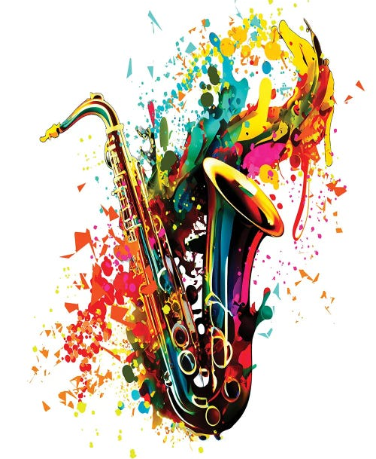
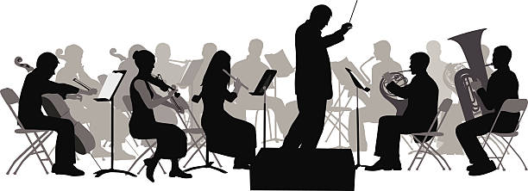

THE
THOMAS ALLEYNE`S HIGH SCHOOL: MUSIC :
PROGRESS
LEARNING JOURNEY
INDIVIDUALITY
OPPORTUNITY
Complete focus on revision for MUO3 as all elements for MUO1 and MUO2 now completed.
Practice papers for all 13 set works and practice for questions 1 to 6 for the exam paper.
Completion of Stravinsky and Petals analysis.
All question types practiced for AOS 6 and for other Areas of Study for MUO 3.
Petals and Stravinsky analysis.
Final
Listening and apprising exam
Subject goes into review in preparation for exam
Final coursework recording
Area of study 6:
New directions
Introduction to Question 5 and continuation of wider listening.
Complete analysis of Clara Schumann and Berlioz and begin AOS 3: Film Music.
Wider Listening continued.
Question 4 practice in addition to continued practice of Questions 1, 2, 3, 5, and 6.
Wider Listening continued.
Continued work on AOS 4: Pop and Jazz. Complete analysis of Beatles, Kate Bush and Courtney Pine.
Continued practice on exam style questions.
Year
13
Area of study 5:
Fusions
Area of study 4:
Pop and Jazz music
Area of study 4:
Pop and Jazz music continued
Fusions: Debussy and Anoushka Shankar analysis.
Area of study 3:
Film music
Focus on Question 6 and practice essay writing.
Analyse Clare Schumann Piano Trio and begin Berlioz Symphonie Fantastique.
Wider Listening continued
MUO1: Performance
Pupils work throughout Year 12 and 13 to develop their music performance skills, culminating in a final project in Year 13 of an 8 minute Performance Recital.
Introduction to AOS 1: Vocal Music. Study of Bach ‘ Eine Feste Burg’ and then a related link to the introduction of Bach Chorale composition techniques for MUO2
Wider Listening Continued as prep for Questions 5 and 6.
MUO2: Composition.
Pupils work throughout Year 12 and 13 to develop their composition skills, culminating in a final project of a 4 minute free composition and 2 minutes of a composition techniques paper released in April of Year 13.
Area of study 2:
Instrumental music
Area of study 1:
Vocal music
Introduction to the 13 set works
Introduction to analysis of music. Review of the musical elements.
Listening to All six Areas of Study for MUO3 and an introduction to each set work.
Introduction to Question 5 and Wider Listening.
Continuation of AOS 1: Vaughan Williams ‘On Wenlock Edge’.
Analysis applying musical elements.
Introduction to AOS 2: Instrumental Music
Year
12

Slide 2
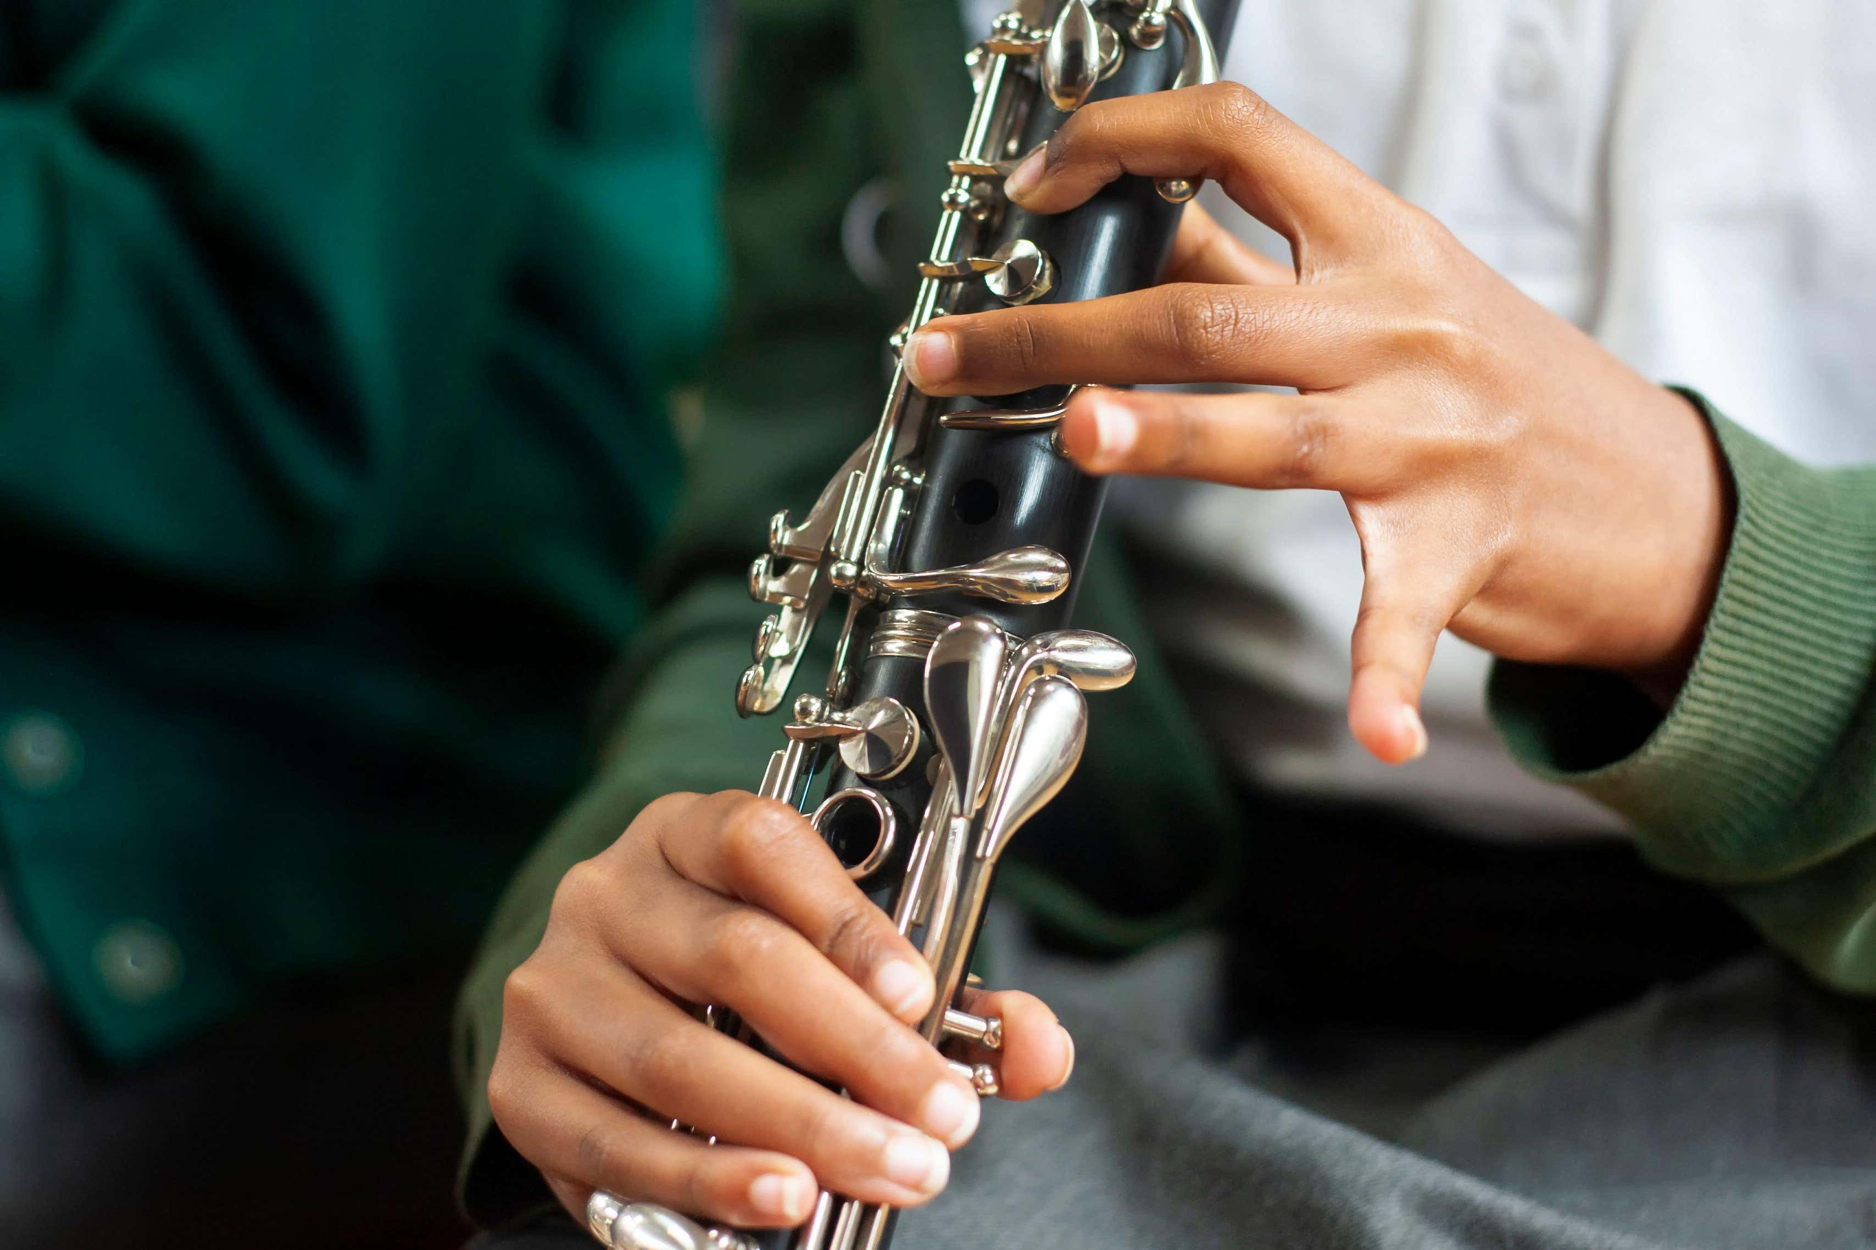

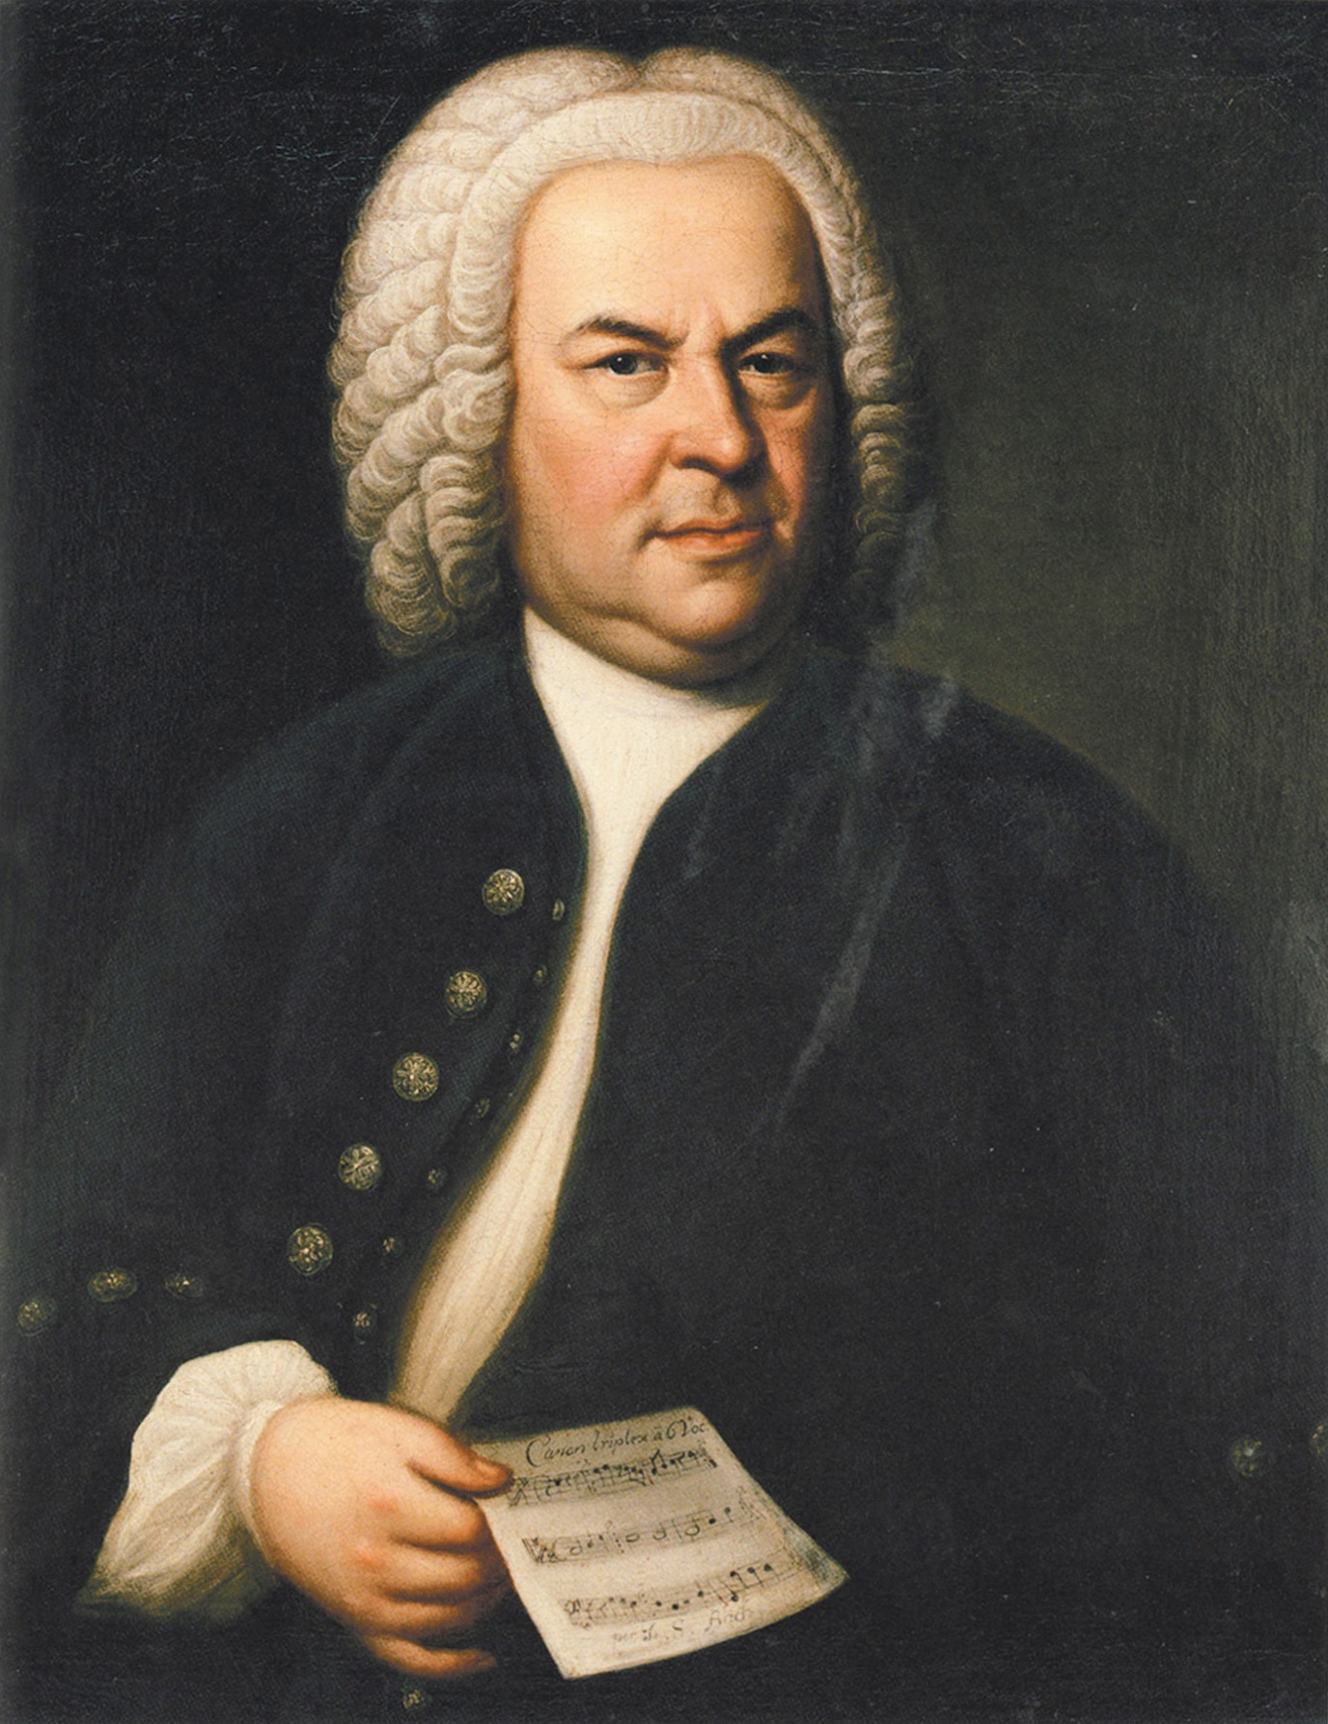
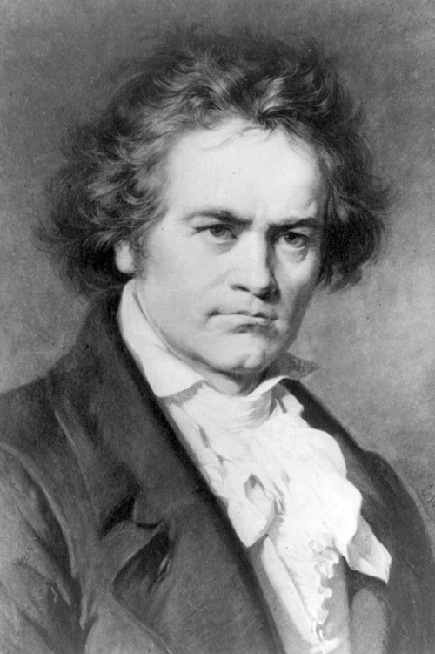
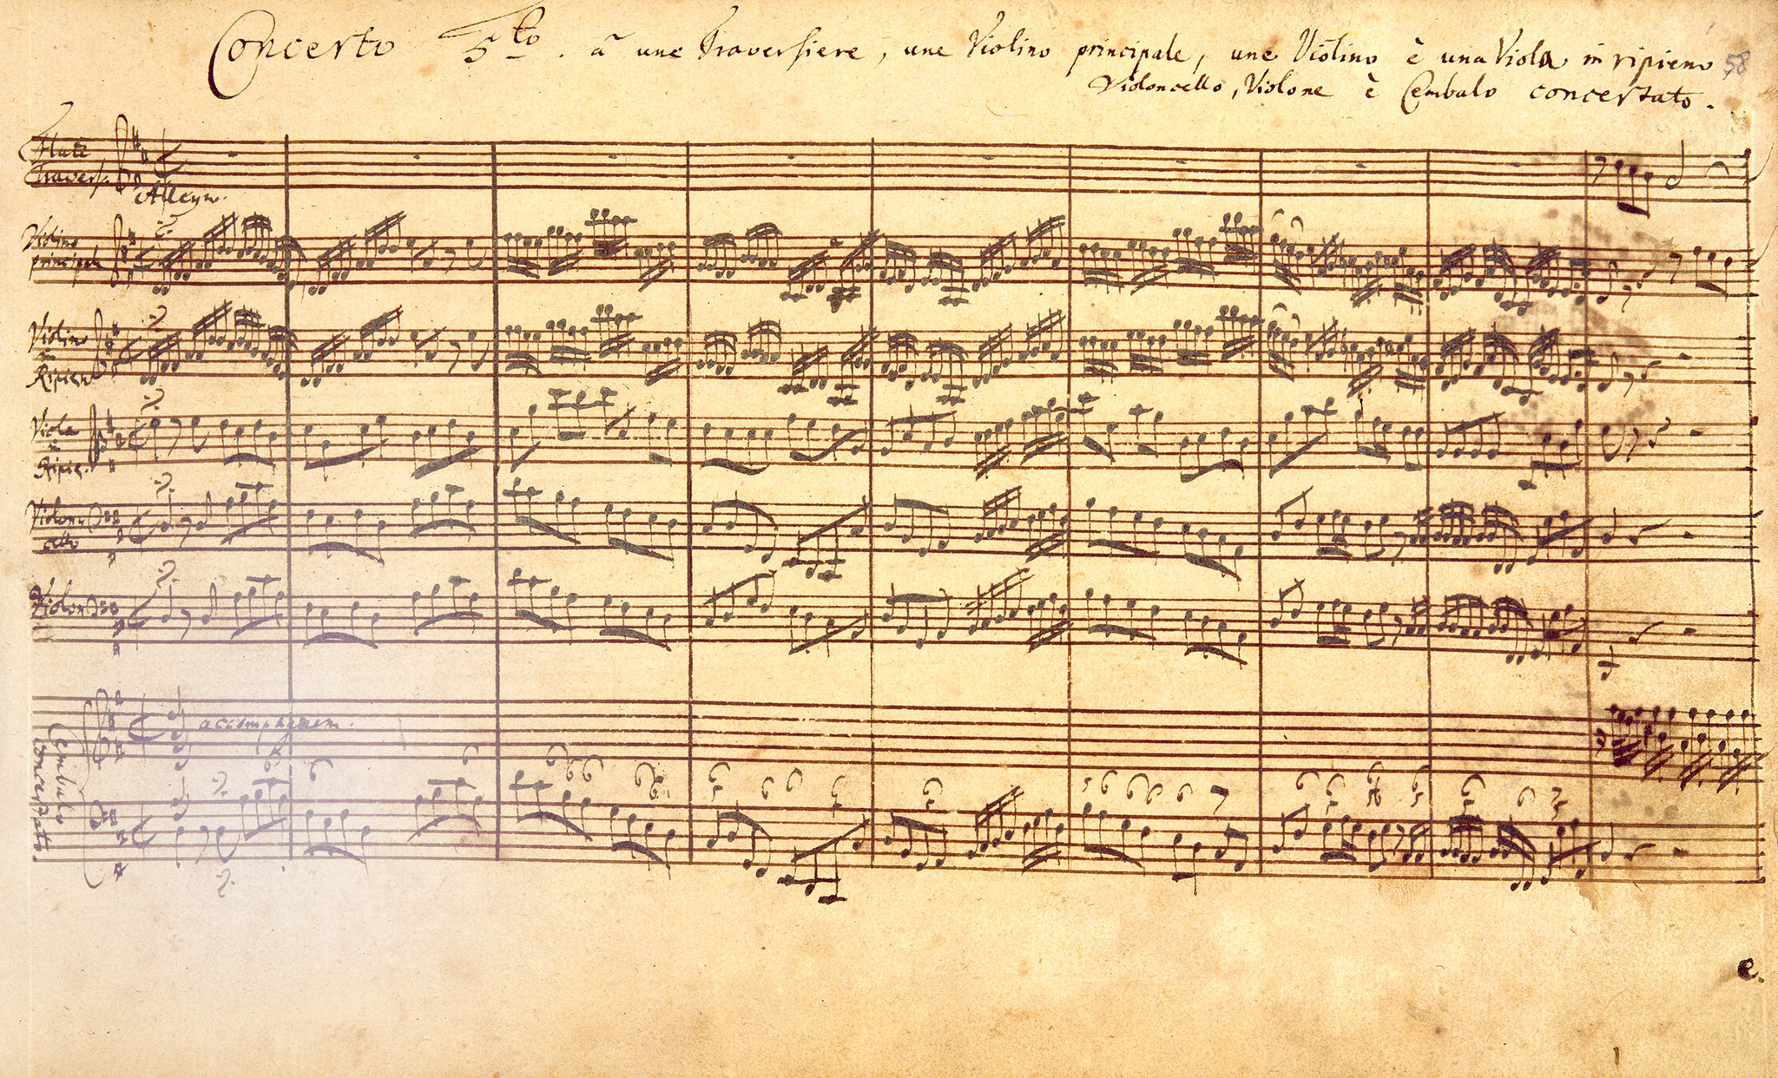
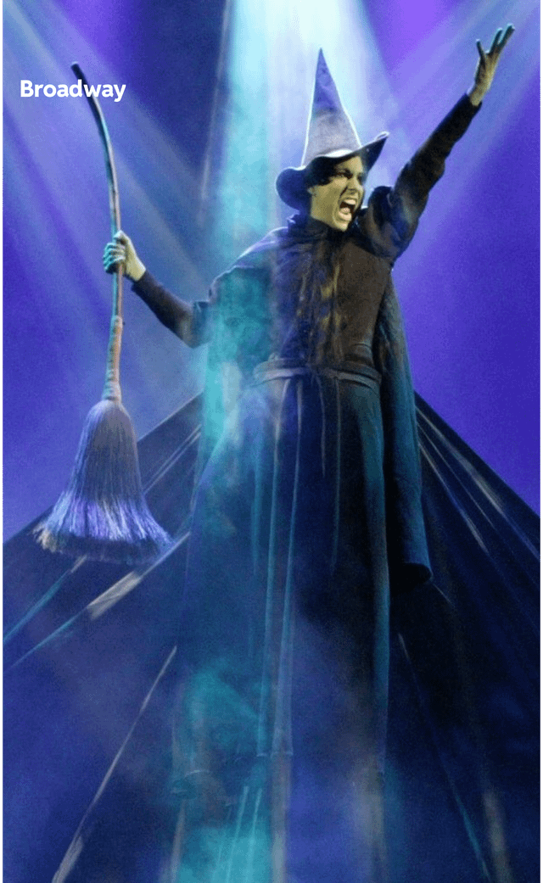
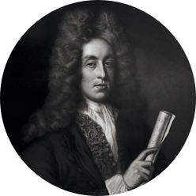

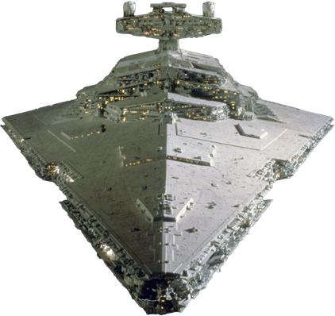
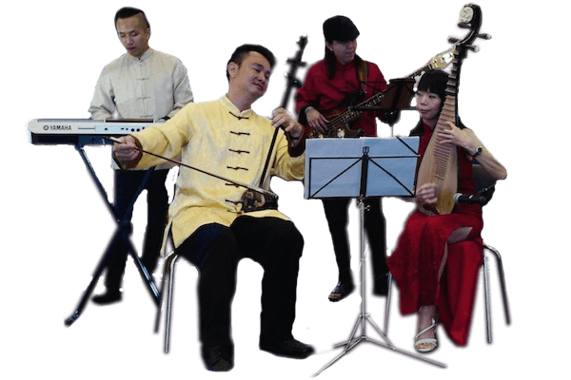

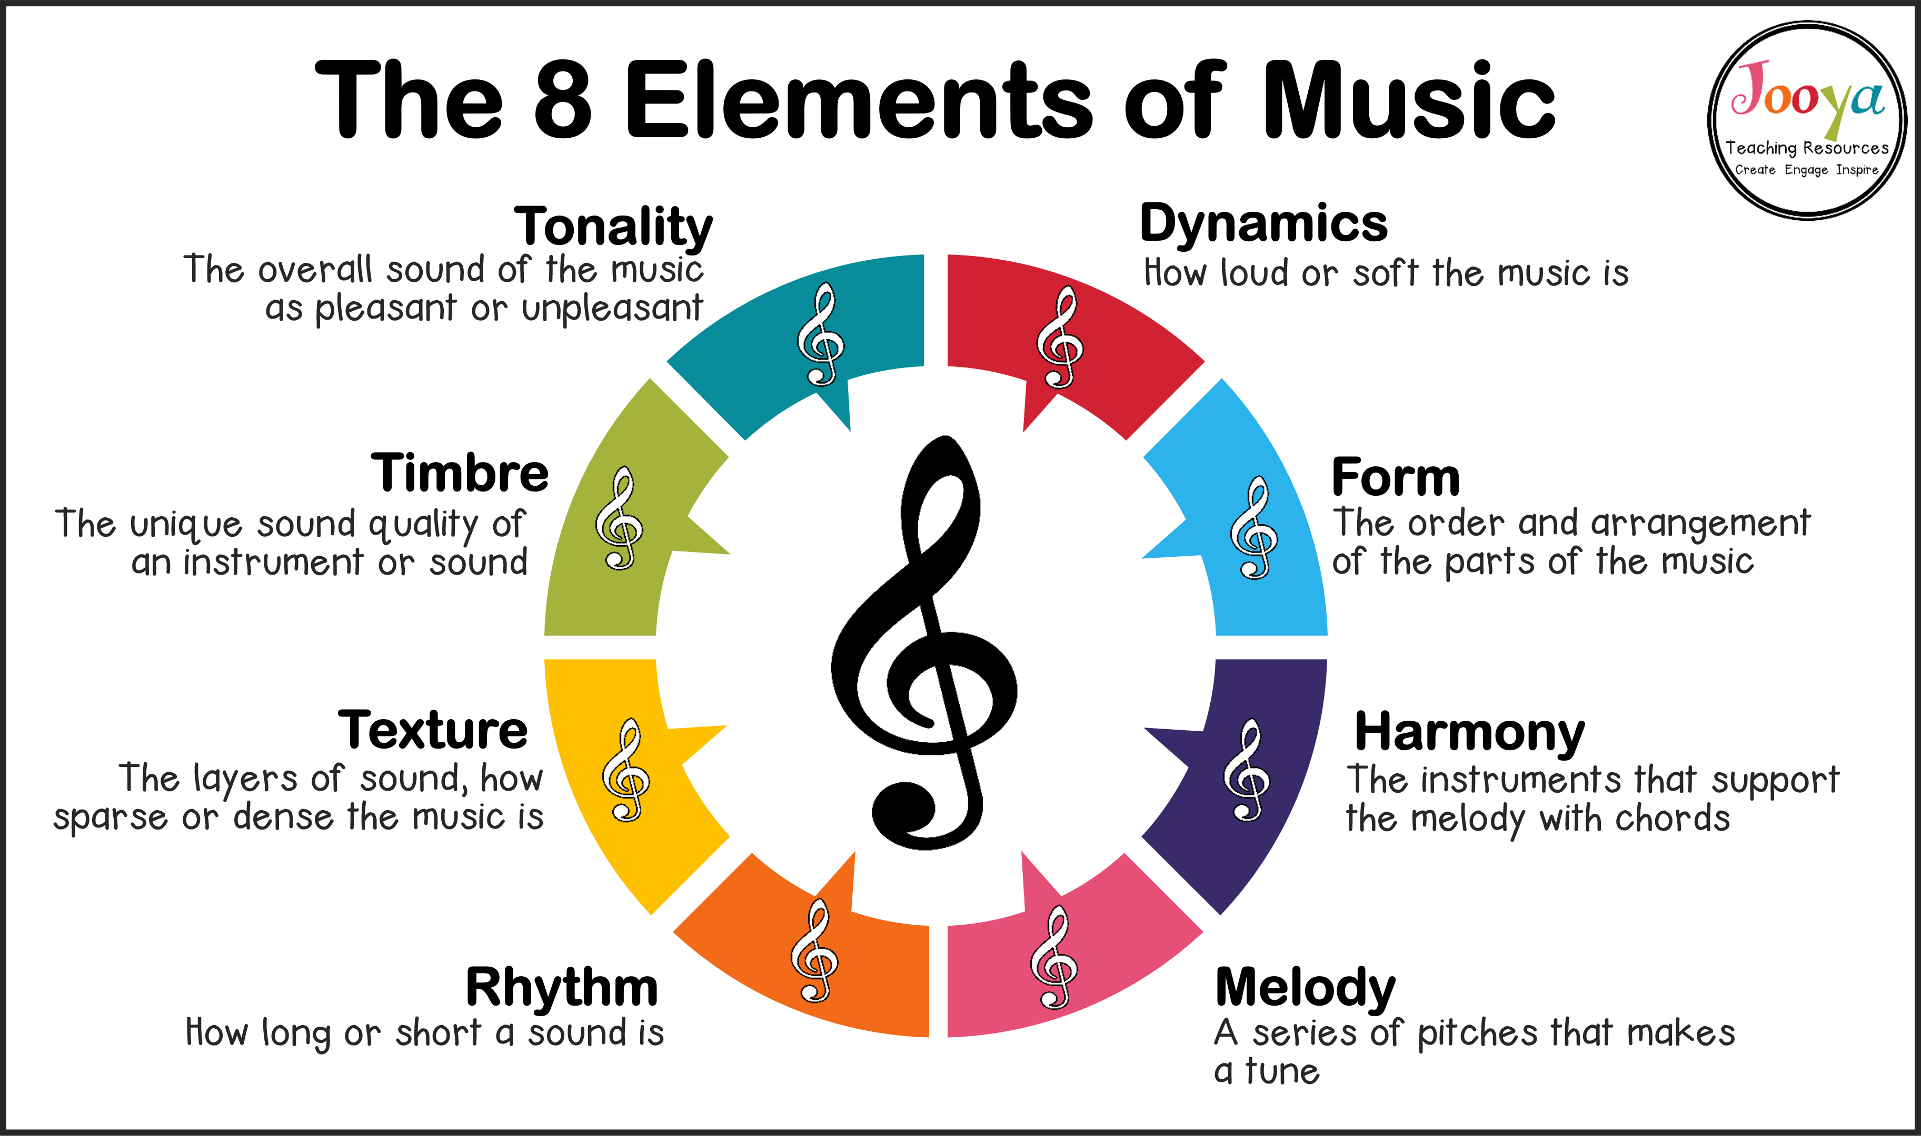
THE
THOMAS ALLEYNE`S HIGH SCHOOL: MUSIC :
PROGRESS
LEARNING JOURNEY
INDIVIDUALITY
OPPORTUNITY
Performance Mock 3
2-minute Brief Composition
A
6TH FORM
Final
Listening and apprising exam
Subject goes into review in preparation for exam
Essay Skills
POST-16 PATHWAY
College/Apprenticeships
Performance Mock 2
1-minute Brief Composition
Unfamiliar Music
1-minute Free Composition
Instrumental Music
Year
11
Elements of Music
Stage and Screen
Overarching statement
Students develop confident performing, composing and listening skills, exploring diverse musical styles and cultures to understand how music expresses identity and meaning.
2-minute Free Composition
Musical Fusions
Vocal Music
Elements of Music
Performance Mock 1
Year
10
30s Composition mock

Slide 3

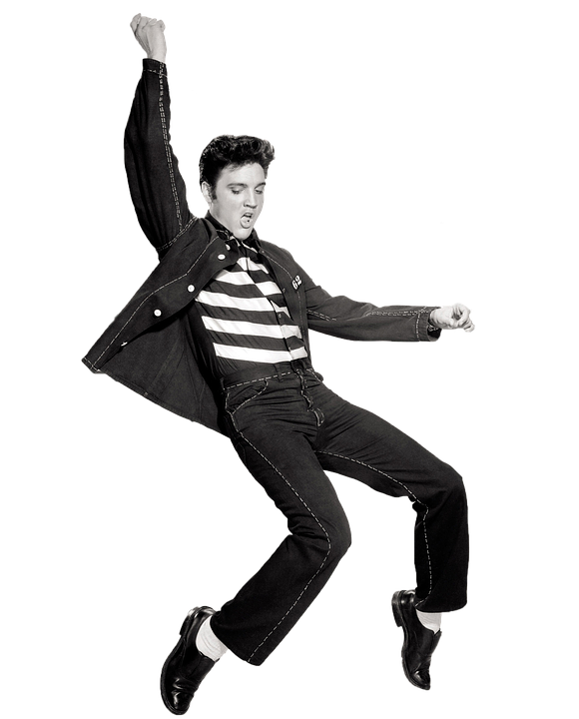


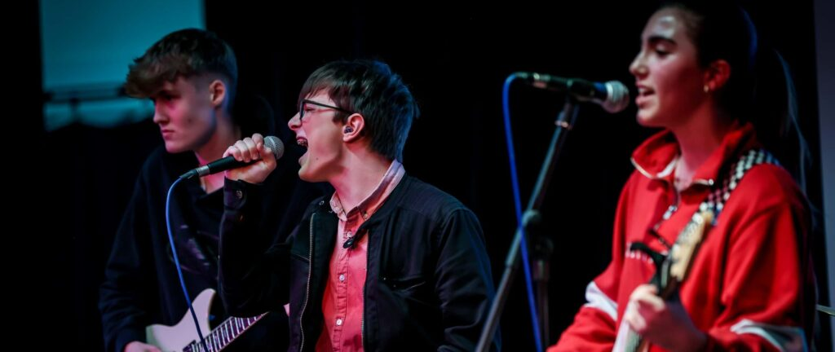
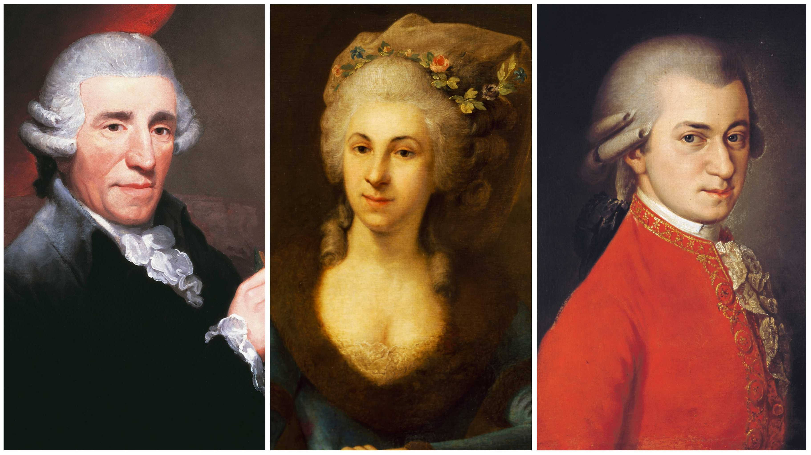
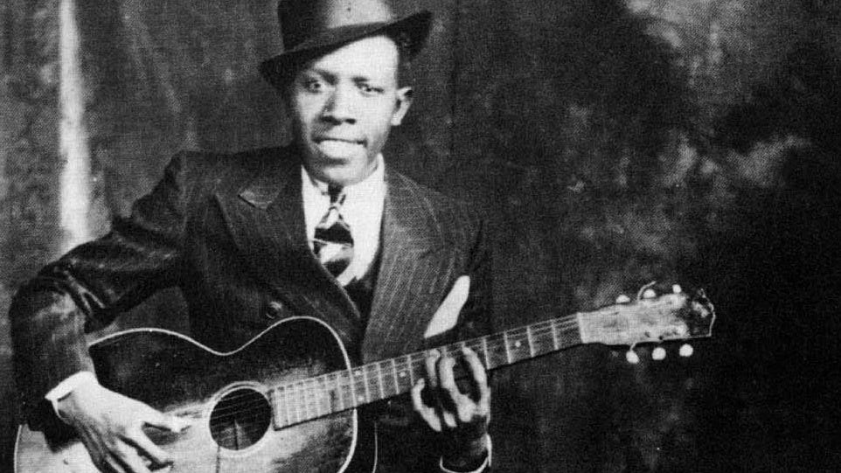

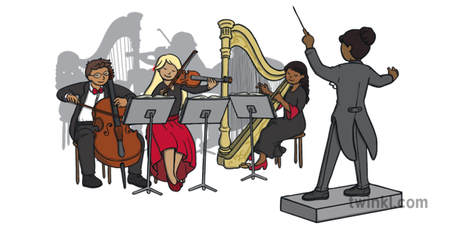
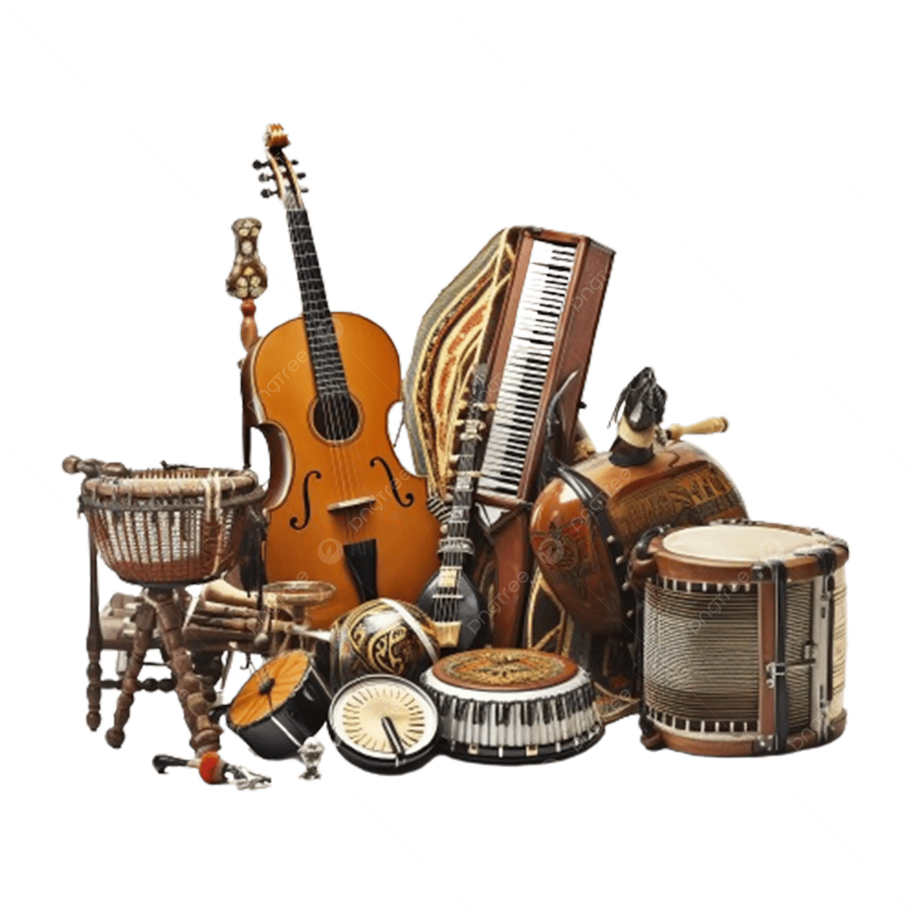


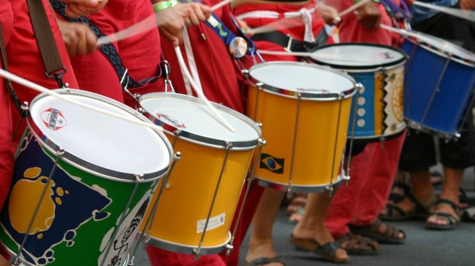
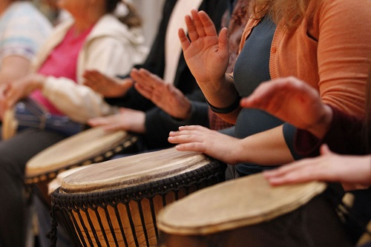
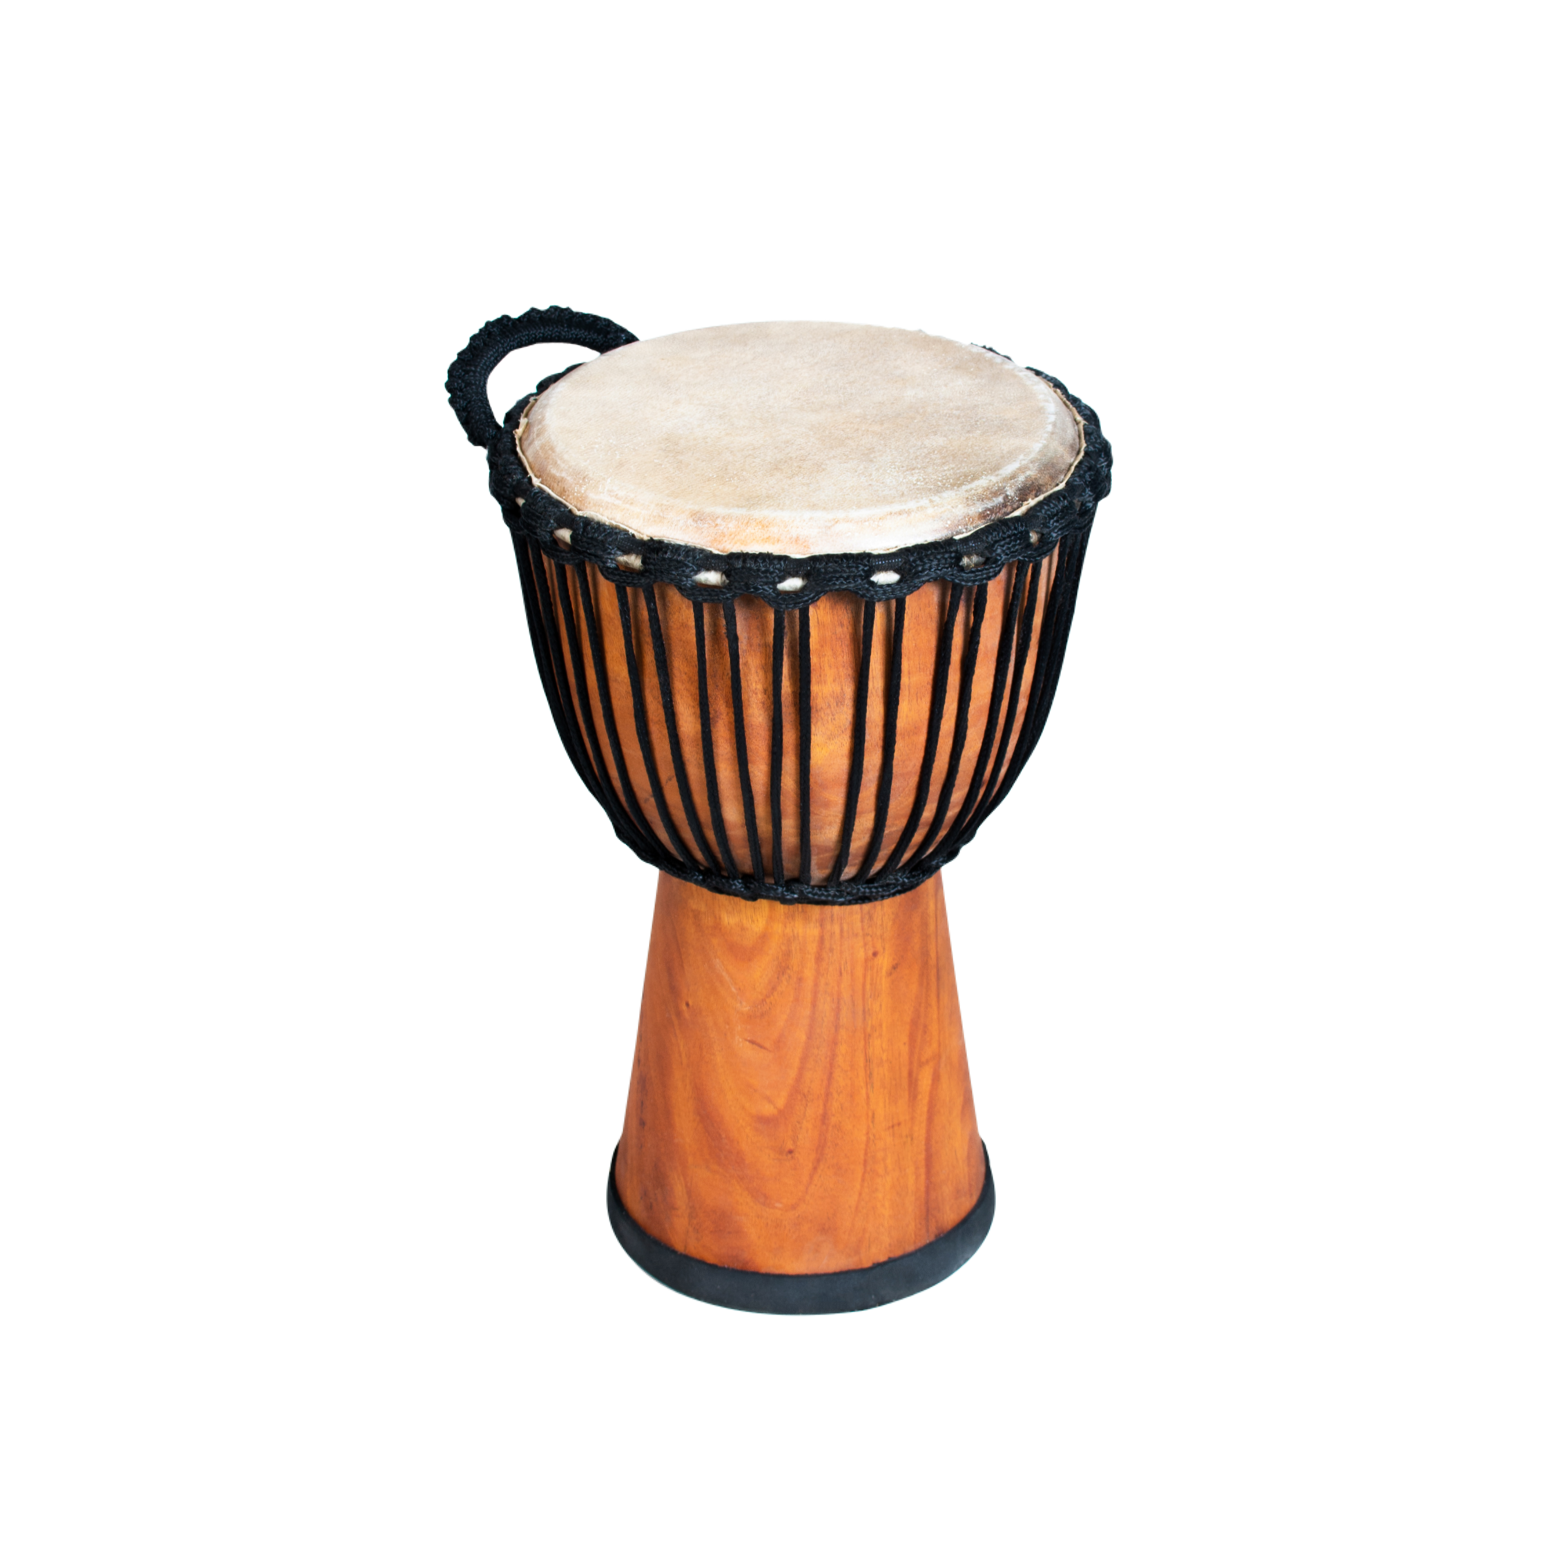
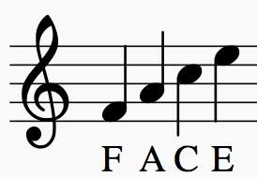
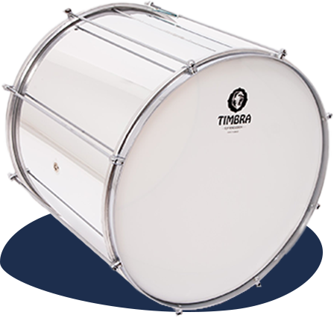
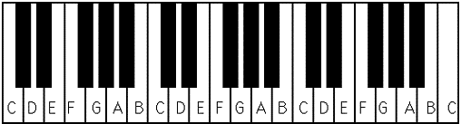
THOMAS ALLEYNE`S HIGH SCHOOL: MUSIC :
PROGRESS
LEARNING JOURNEY
INDIVIDUALITY
OPPORTUNITY
Mickey Mousing
Motif
Group Performance
Dictation Practice
Elements of Music
Style and era recognition
Band Workshop
Icons of Pop
Keyboard Composition to a film clip live in class
Element of Music analysis
Longer written questions
Year
10
Film Music
Pop Music
History of the Blues
Features of the Blues
Instruments of the Blues
Group Performance
Solo Compositions – Improvisation
Dictation Practice
Elements of Music
Composers
Melodic Dictation
Keyboard Skills
Instrument Recognition
Analysis through the elements of music
Solo performances
Keyboard Composition
Orchestra
Western Classical Music
The Blues
African Drumming
Carols
Samba
Notation
Calypso
Christmas Music
World Rhythms
Keyboard Skills
Notes on the Keyboard
Notes on the stave
Instrument Recognition
Analysis through the elements of music
Solo performances
Group singing
Overarching statement
Pupils are able to accurately describe effect in various genres of music and perform those effects in solo, pair, and group circumstances
Rhythmic Dictation
Instrument Recognition
Analysis through the elements of music
Group performances
Group compositions
Year
9

