Slide 1

How to keep everything in perspective

Slide 2
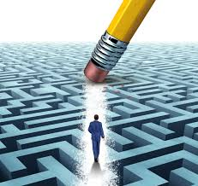
Positive Psychology
Positive psychologists believe that, to create happiness, you need 3 good experiences to every bad one.
This is a great tool to have if you tend to dwell on the negative things.

Slide 3
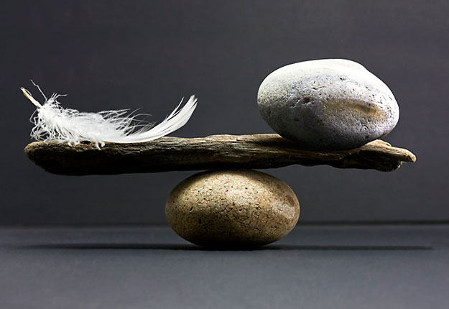
3:1
Think about or write down one thing that’s really bugging you right now.
Now think about 3 good things in your life (come back to your gratitude list if you need to).
Take a few minutes to reflect on this.
Keep the balance.

Slide 4
Good Things
Good things don’t have to be huge but they do add up, such as:
Family
Friends
A test you did well in (or a pat on the back for joining the sixth form)
A pet who loves you
Your hair looks great today
Soon there will be a holiday
You’re alive!

