Slide 1
Am I Happy With Me?
https://www.youtube.com/watch?v=y6Sxv-sUYtM

Slide 2
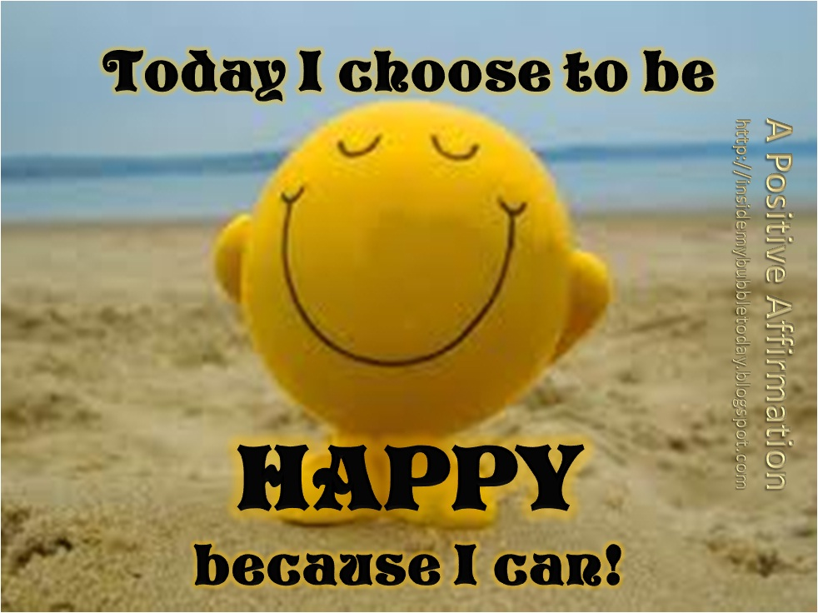
How Often Are You Positive About Yourself???
Humans are pre-disposed to focus on the bad rather than the good.
Sometimes we need to be reminded about all the good things.

Slide 3
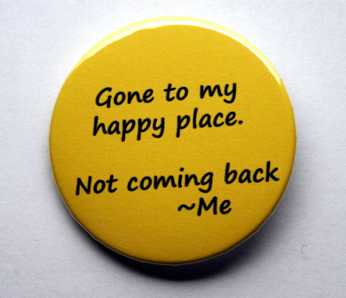
Gratitude
Gratitude – create a list of what you feel thankful for:
1. What went well yesterday?
2. What is good in your life today?
3. What part did I play in making the good thing happen?
Come back to these thoughts if you feel your gratitude or mood dipping ☺
Try to build this into your daily routine (eg when falling asleep)

